Slide 1




Exploratory Data Analysis Project
Nov 2021
Lee’s Pizza - NYC Market Entry
Prepared by: Li Sun

Slide 2


Introduction
Motivation -
Lee’s Pizza is a brick & mortar pizza store that serves pizza late night.
They’ve always been interested in opening a store in Manhattan to cater to the evening & late night nightlife party crowd.
Lee’s pizza specializes in a grab-and-go store (no delivery) and is only interested in opening at a non-touristy Manhattan Neighborhood.
Problem -
Lee’s Pizza doesn’t know much about NYC and hires Li Sun to provide answers to the following questions:
What Manhattan neighborhood(s) should Lee’s Pizza consider opening a store?
Should they expand beyond their normal hours of operation (8pm-4am)?
Due to the impact of Covid Pandemic, should they enter NYC in 2021?
Goal – Analyze MTA Data to answer the three questions
Notes:
An application program interface (API) is a piece of software code that allows two software programs to communicate with each other
APIs connect business processes, services, content and data to customers, staff and developers in an easy and secure way making it possible to easily connect differing sources of data
External APIs improve connectivity to the world, while internal APIs enable the enterprise to operate more efficiently
They are the digital glue in the digital value chain, powering mobile and web apps, connecting disparate systems, and enabling innovation

Slide 3
Methodology - What Manhattan neighborhood(s) should Lee’s Pizza considering opening?
Methodology –
Potential customers are Nightlife people, who are hungry for slices of pizza
Use MTA Subway Turnstile data of subway stations located in each of the target Manhattan neighborhoods to gauge foot traffic of potential pizza customers
6 Target Neighborhoods (13 Subway Stations) based on Manhattan Nightlife Establishment Density (e.g. Bars, Clubs, see Appendix)
1. East Village & 2. West Village
3. Hell’s Kitchen
4. NoMad / Rose Hill & 5. Murray Hill
6. Lower East Side
Evaluate Daily Foot traffic / # of competitors in each target neighborhood
Assumptions
Majority of late night traffic of potential late night pizza buyers (NightLife partiers) takes the subway
Majority of nightlife partier party in more than one neighborhood per night
Healthy conversion rate of foot traffic to Pizza sales
Data – 15 weeks of 2019 MTA Turnstile Data (July 02 – Oct 30, 2019)
Metrics –
Total Foot Traffic (Entry + Exit) per target neighborhood
Total Competitors / Target Neighborhood
Foot Traffic / Competitor – desire is highest foot traffic, lowest competitor
Notes:
An application program interface (API) is a piece of software code that allows two software programs to communicate with each other
APIs connect business processes, services, content and data to customers, staff and developers in an easy and secure way making it possible to easily connect differing sources of data
External APIs improve connectivity to the world, while internal APIs enable the enterprise to operate more efficiently
They are the digital glue in the digital value chain, powering mobile and web apps, connecting disparate systems, and enabling innovation

Slide 4
Methodology - Should Lee’s expand beyond their normal hours of operation?
Methodology –
Use MTA data to conduct a times series of the average Foot Traffic / station in the Targeted Neighborhoods.
Data – 15 weeks of 2019 MTA Turnstile Data (July 02 – Oct 30, 2019)
Metrics –
Foot Traffic / 4 Hour Block of Time
Notes:
An application program interface (API) is a piece of software code that allows two software programs to communicate with each other
APIs connect business processes, services, content and data to customers, staff and developers in an easy and secure way making it possible to easily connect differing sources of data
External APIs improve connectivity to the world, while internal APIs enable the enterprise to operate more efficiently
They are the digital glue in the digital value chain, powering mobile and web apps, connecting disparate systems, and enabling innovation

Slide 5
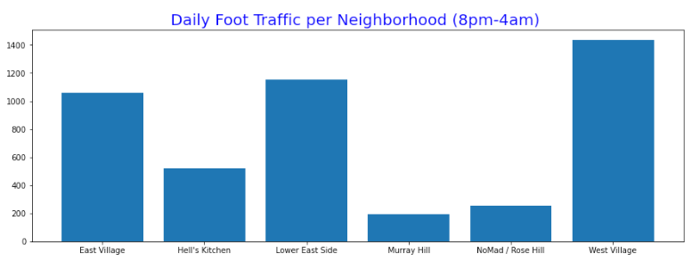
Results – Two Neighborhood to consider for opening Lee’s Pizza store
West Village, East Village, and Lower East Side has the most Daily Foot Traffic between 8pm-4am
But West Village and NoMad has the most foot traffic with least # of competitors
Neighborhood | Daily Foot_Traffic (8pm-4am) | Competitors | Foot Traffic / Competitor
East Village | 1,056 | 7 | 151
Hell's Kitchen | 520 | 5 | 104
Lower East Side | 1,153 | 9 | 128
Murray Hill | 192 | 3 | 64
NoMad / Rose Hill | 252 | 1 | 252
West Village | 1,436 | 5 | 287
Notes:
An application program interface (API) is a piece of software code that allows two software programs to communicate with each other
APIs connect business processes, services, content and data to customers, staff and developers in an easy and secure way making it possible to easily connect differing sources of data
External APIs improve connectivity to the world, while internal APIs enable the enterprise to operate more efficiently
They are the digital glue in the digital value chain, powering mobile and web apps, connecting disparate systems, and enabling innovation

Slide 6
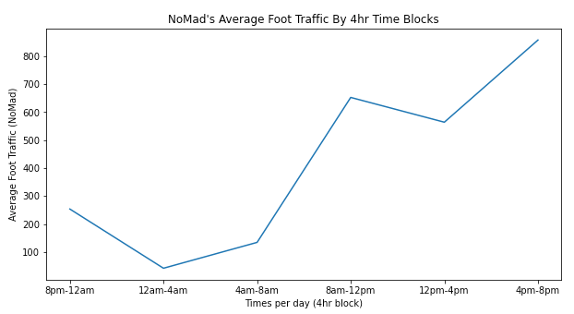
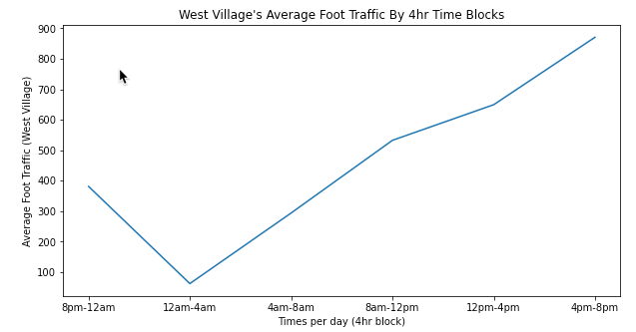
Results
Notes:
An application program interface (API) is a piece of software code that allows two software programs to communicate with each other
APIs connect business processes, services, content and data to customers, staff and developers in an easy and secure way making it possible to easily connect differing sources of data
External APIs improve connectivity to the world, while internal APIs enable the enterprise to operate more efficiently
They are the digital glue in the digital value chain, powering mobile and web apps, connecting disparate systems, and enabling innovation

Slide 7
Conclusion
Based on the information given:
Recommend Lee’s Pizza to explore opening a store in West Village and NoMad
Recommend Lee’s Pizza to expand outside their hours of operations in order to capture significantly higher foot traffic at both locations.
Notes:
An application program interface (API) is a piece of software code that allows two software programs to communicate with each other
APIs connect business processes, services, content and data to customers, staff and developers in an easy and secure way making it possible to easily connect differing sources of data
External APIs improve connectivity to the world, while internal APIs enable the enterprise to operate more efficiently
They are the digital glue in the digital value chain, powering mobile and web apps, connecting disparate systems, and enabling innovation

Slide 8
Appendix

Slide 9
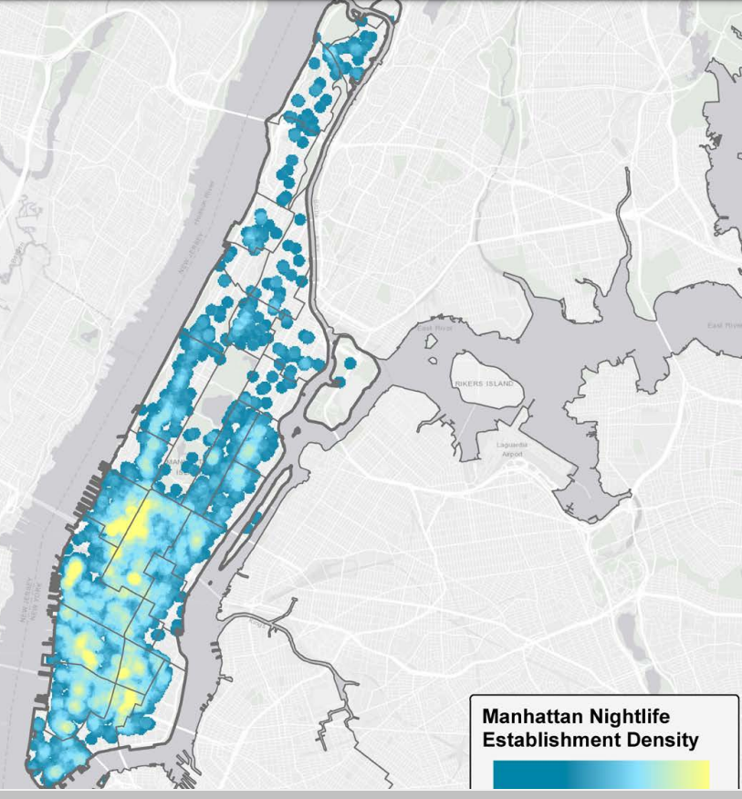
Appendix 1 – Manhattan Nightlife Establishment Density
https://www1.nyc.gov/assets/mome/pdf/ESI-NYCEDC-Nightlife-Report-2018.pdf
Notes:
An application program interface (API) is a piece of software code that allows two software programs to communicate with each other
APIs connect business processes, services, content and data to customers, staff and developers in an easy and secure way making it possible to easily connect differing sources of data
External APIs improve connectivity to the world, while internal APIs enable the enterprise to operate more efficiently
They are the digital glue in the digital value chain, powering mobile and web apps, connecting disparate systems, and enabling innovation

